Slide 1

Win-GRAF
PAC Platform
2017/07/24

Slide 2
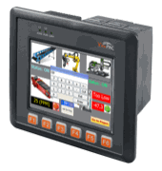
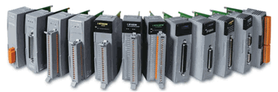
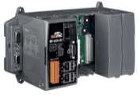


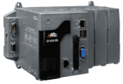


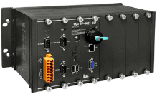
Hardware Platform List
ViewPAC series
WinPAC series
XP-8000 series
WP-9000 series

Slide 3
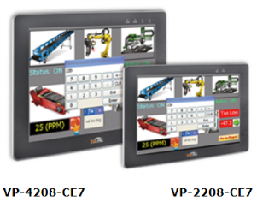
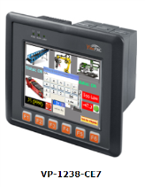
ViewPAC series
VP-1238-CE7: Support I-8K, I-87K series
VP-4208-CE7
VP-2208-CE7
VP-1238-CE7
Model | OS | LCD | CPU | RAM | Flash | Ethernet | I/O Slots
VP-2208-CE7 | WinCE 7.0 | 7” (800x480) | 720 MHz | 512 MB | 256 MB | 1x 10/100/100M | N/A
VP-4208-CE7 |  | 10.4” (800x600) | 1.0 GHz |  |  |  | N/A
VP-1238-CE7 |  | 5.7” (640x480) |  |  |  |  | 3

Slide 4
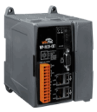
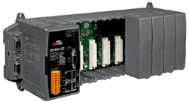
WP-8x48 vs WP-8x28-CE7
Support I/O Modules: same (I-8K, I-87K series)
Dimensions: same (WP-8x4x = WP-8x2x)
Model | OS | VGA Resolution | CPU | RAM | Flash | Ethernet
WP-8128-CE7 | WinCE 7.0 | 1024x768 | 1.0 GHz | 512 MB | 256 MB | 2x 10/100/100M
WP-8428-CE7
WP-8828-CE7
WP-8148 | WinCE 5.0 | 800x600 | 520 MHz | 128 MB | 96 MB | 2x 10/100M
WP-8448
WP-8848

Slide 5
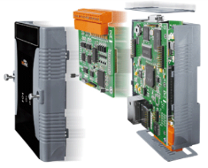
WP-5238-CE7
Support I/O Modules: XV-board
Model | OS | VGA Resolution | CPU | RAM | Flash | Ethernet
WP-5238-CE7 | WinCE 7.0 | 1024x768 | 1.0 GHz | 512 MB | 256 MB | 1x 10/100/100M

Slide 6
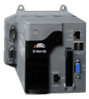
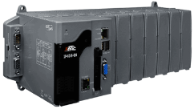
XP-8x48-CE6 series
Support I/O Modules: same (I-8K, I-87K series)
Model | OS | VGA Resolution | CPU | RAM | Flash | Ethernet
XP-8048-CE6 | WinCE 6.0 | 1024x768 | 500 MHz | 512 MB | 4 GB | 2x 10/100M
XP-8348-CE6
XP-8748-CE6
Note: the XP-8x48-CE6 series will be EOL before 2018/12/31 (because the hardware key component is discontinue).

Slide 7
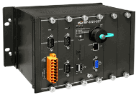
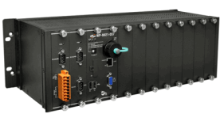
WP-9x28-CE7 series
Support I/O Modules: same (I-9K, I-97K series)
Model | OS | VGA Resolution | CPU | RAM | Flash | Ethernet
WP-9128-CE7 | WinCE 7.0 | 1024x768 | 1.0 GHz | 512 MB | 256 MB | 2x 10/100/100M
WP-9428-CE7
WP-9828-CE7

Slide 8

Dimensions
Model | Housing Material | Width (mm) | Height (mm) | Depth (mm)
WP-8148 WP-8128-CE7 | Plastic | 95 | 132 | 111
WP-8148 WP-8128-CE7 |  | 231
WP-8148 WP-8128-CE7 |  | 355
XP-8048-CE6 | Plastic | 137 | 132 | 125
XP-8348-CE6 |  | 231
XP-8748-CE6 |  | 355
WP-9228-CE7 | Metal | 239 | 133 | 164
WP-9428-CE7 |  | 330
WP-9828-CE7 |  | 422

Slide 9
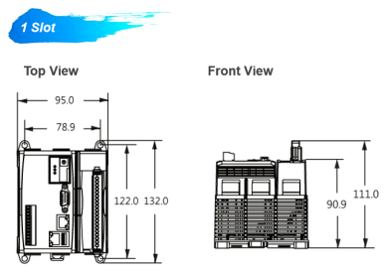
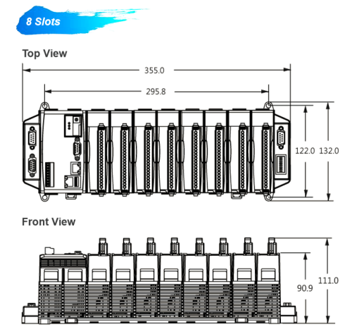
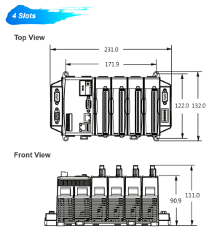
Dimensions (WP-8xxx)

Slide 10
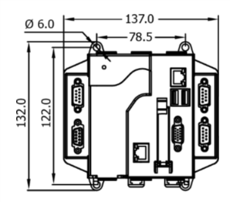
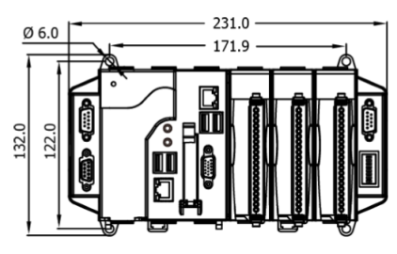
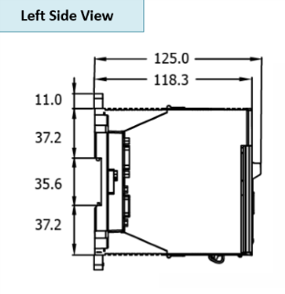
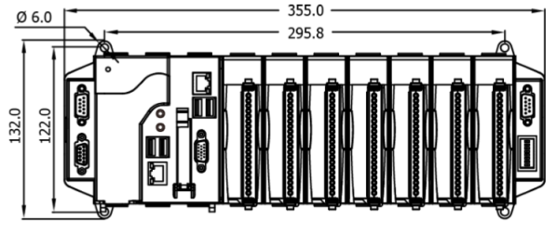
Dimensions (XP-8xx8-CE6)

Slide 11
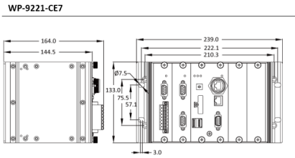
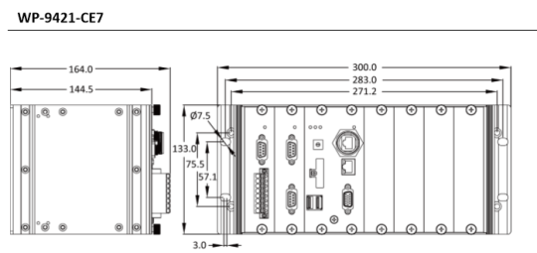
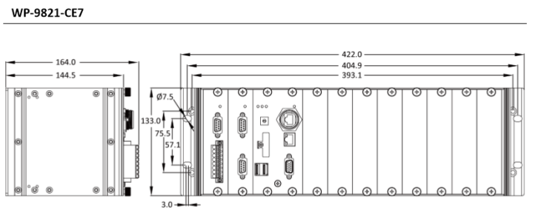
Dimensions (WP-9x2x-CE7)

Slide 12

Thank you very much!
Page 12

