Slide 1
Win-GRAF
July 01, 2018

Slide 2
What is Win-GRAF?
A Programming Tool supports IEC61131-3 Standard
Programming Languages:
Ladder Diagram (LD)
Function Block Diagram (FBD)
Structured Text (ST)
Sequential Function Chart (SFC)
Instruction List (IL)
An Useful Debugging Tool

Slide 3
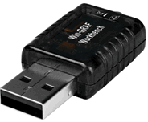
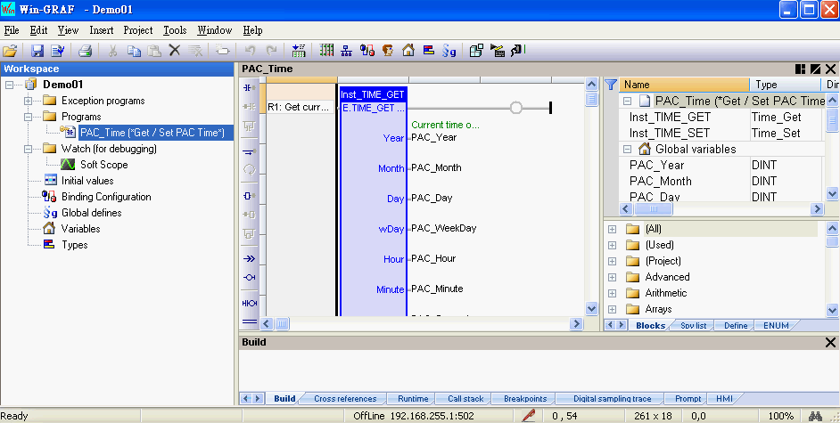
Win-GRAF Workbench
Available on Windows XP/7/8/10 (32-bit or 64-bit)
Delivered with a Win-GRAF USB Dongle.
It becomes Trial (Demo) Version if without the USB Dongle.
Program Editor
Variables
FBD & others
Message

Slide 4
Protocols embedded in the Win-GRAF PAC
Modbus TCP (Slave, Master)
Modbus RTU (Slave, Master)
Modbus UDP (Master)
Modbus ASCII (Master)
DCON (ICP DAS I-7000 series modules, RU-87P8/P4 + I-87xxxW cards,
I-87K8/K4 + I-87xxxW cards)

Slide 5
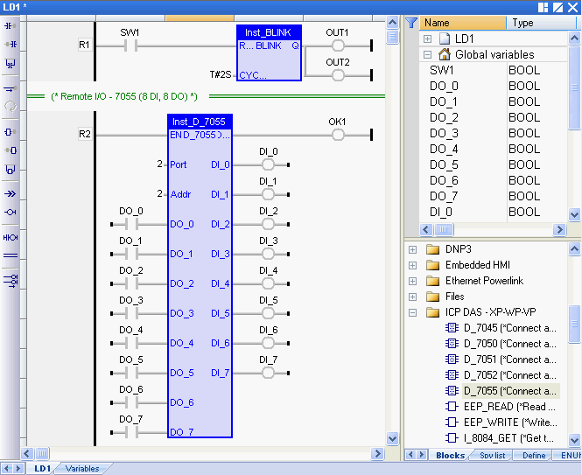
Ladder Diagram

Slide 6
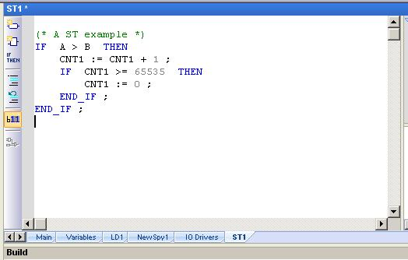
ST

Slide 7
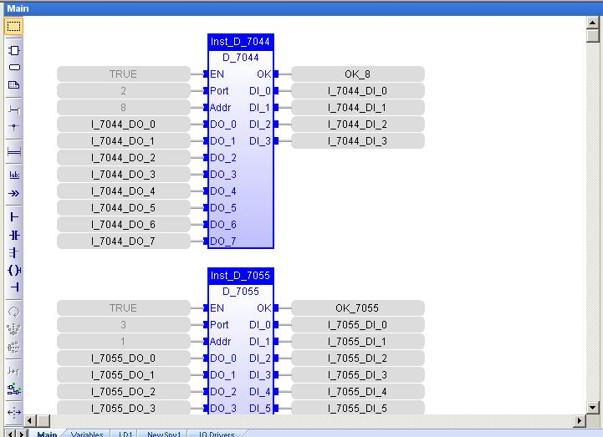
FBD

Slide 8
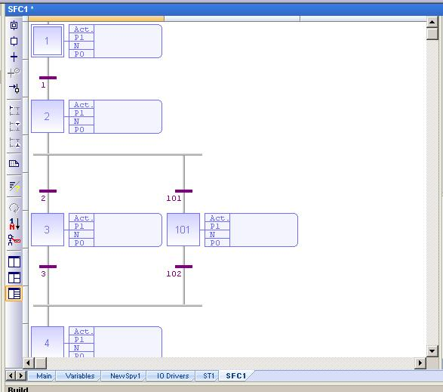
SFC

Slide 9
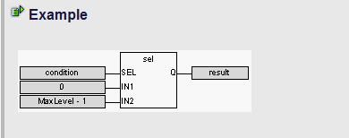
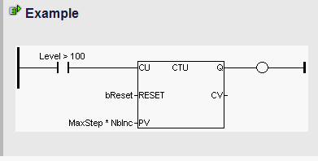
Uses ST in Graphical Editor
FBD
LD

Slide 10



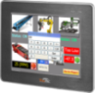
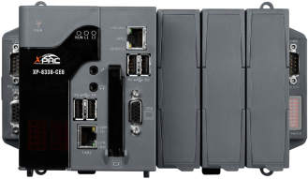
Win-GRAF PAC
(Programmable Automation Controller)
WP-8148/8448/8848
WP-8128-CE7/8428-CE7/8828-CE7
WP-5238-CE7 (1x LAN)
VP-1238-CE7 ( 5.7”, 3x I/O Slots)
VP-2208-CE7 ( 7” , w/o I/O Slot)
VP-4208-CE7 (10.4”, w/o I/O Slot)
VP-4238-CE7 (10.4”, 3x I/O Slots)
XP-8038-CE6/8138-CE6/8338-CE6/8738-CE6

Slide 11
Various Local I/O Modules (1)
(Plugged in the PAC)
Digital Input (DI) | I-8040W, I-8046W, I-8051W, I-8052W, I-8053W, I-8053PW, I-87040W, I-87040PW, I-87046W, I-87051W, I-87052W, I-87053W, I-87053PW, I-87053W-A2, I-87053W-A5, I-87053W-E5
Digital Input/Output (DIO) | I-8042W, I-8050W, I-8054W, I-8055W, I-87042W, I-87054W, I-87055W
Digital Output (DO) | I-8037W, I-8041W, I-8041AW, I-8056W, I-8057W, I-87037W, I-87041W, I-87057W, I-87057PW
Relay Output | I-8060W, I-8063W, I-8064W, I-8068W, I-8069W, I-87061W, I-87061PW, I-87063W, I-87064W, I-87065W, I-87066W, I-87068W, I-87068W-2A, I-87069W, I-87069PW
AC Input | I-8058W, I-87053W-AC1, I-87058W, I-87059W
Analog Input (AI) | I-8017DW, I-8017HW, I-8017HCW, I-87017W, I-87017RW, I-87017RCW, I-87017DW, I-87017EW, I-87018W, I-87018RW, I-87018PW, I-87018ZW, I-87019PW, I-87019RW, I-87019ZW
Analog Output (AO) | I-8024W, I-87024CW, I-87024UW, I-87024DW, I-87024RW, I-87024W, I-87028CW, I-87028UW, I-87028VW, I-87028VW-20V

Slide 12
Various Local I/O Modules (2)
(Plugged in the PAC)
Multifunction (DIO, AIO) |  | I-87026W
Temperature Input | Thermister | I-87005W
 | RTD | I-87013W, I-87015W, I-87015PW
 | T/C | I-87018W, I-87018RW, I-87018PW, I-87018ZW, I-87019PW, I-87019RW, I-87019ZW
Strain Gauge |  | I-87016W
Counter/Frequency Input |  | I-8084W, I-87082W, I-87084W
Encoder Input |  | I-8093W
PWM Output |  | I-8088W
Communication Module |  | I-8112iW, I-8114W, I-8114iW, I-8142iW, I-8144iW
Temperature & Humidity Input |  | DL-100T485, DL-100T485-W, DL-100T485P, DL-100T485P-W (DCON Protocol) DL-100TM485, DL-100TM485-W, DL-100TM485P, DL-100TM485P-W (Modbus RTU Protocol)

Slide 13
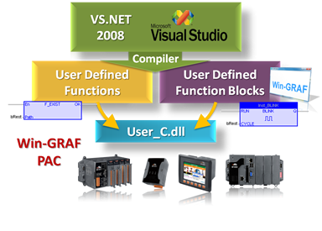
Win-GRAF Features
Create your own C Function & Function Blocks

Slide 14
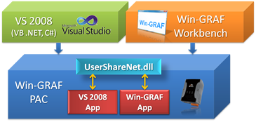
Win-GRAF Features
Working With VB.net , C# App.

Slide 15
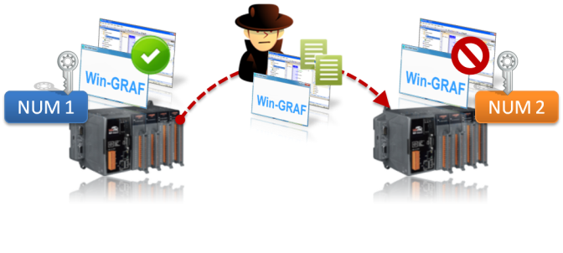
Win-GRAF Features
Protect your Software
Win-GRAF PAC is equipped with a unique 64-bit serial number. It can be used to generate a license key to protect the software against illegal copy.
WP-8xx8
WP-8xx8

Slide 16
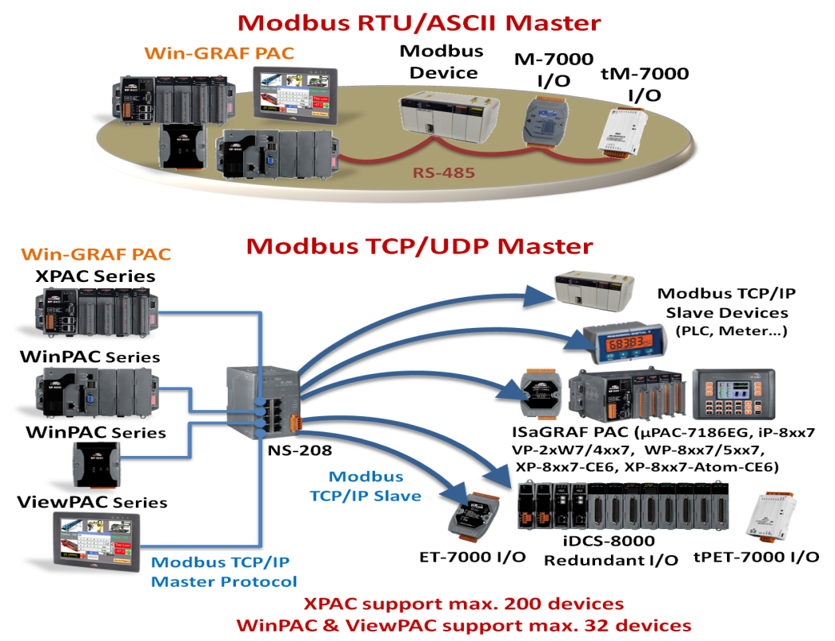
Win-GRAF Features
Multi-Modbus Master

Slide 17
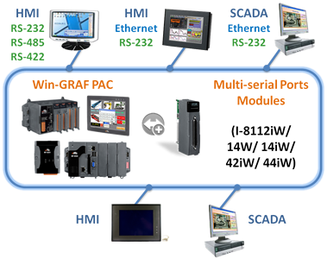
Win-GRAF Features
Multi-Modbus TCP/RTU Slave

Slide 18
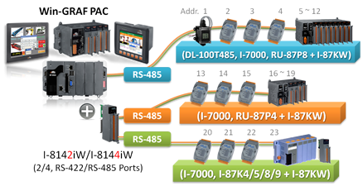
Win-GRAF Features
DCON Remote I/O
18

Slide 19
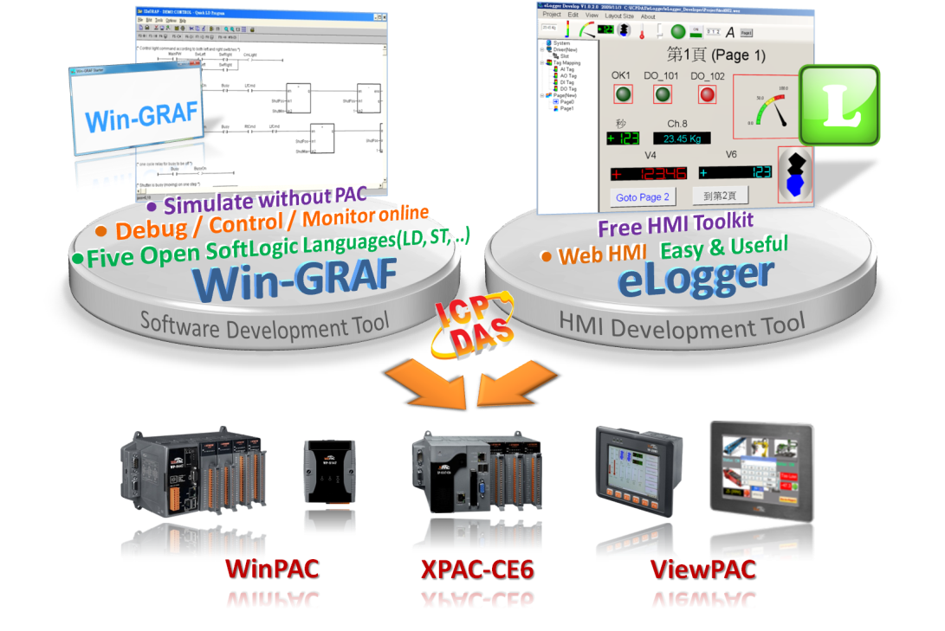
Win-GRAF Features
Local & Web HMI
Support remotely device control by using a smart phone, tablet, or laptop.
19

Slide 20
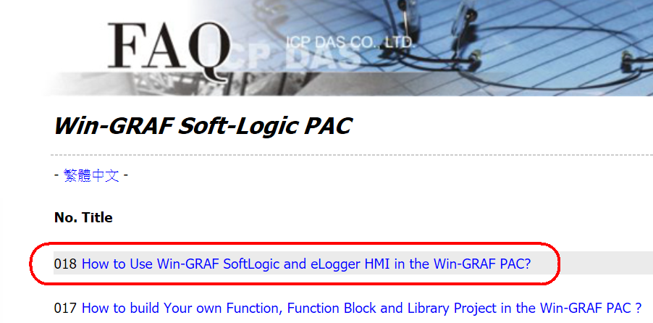
Win-GRAF & eLogger
http://www.icpdas.com/root/support/faq/win-graf.php

Slide 21
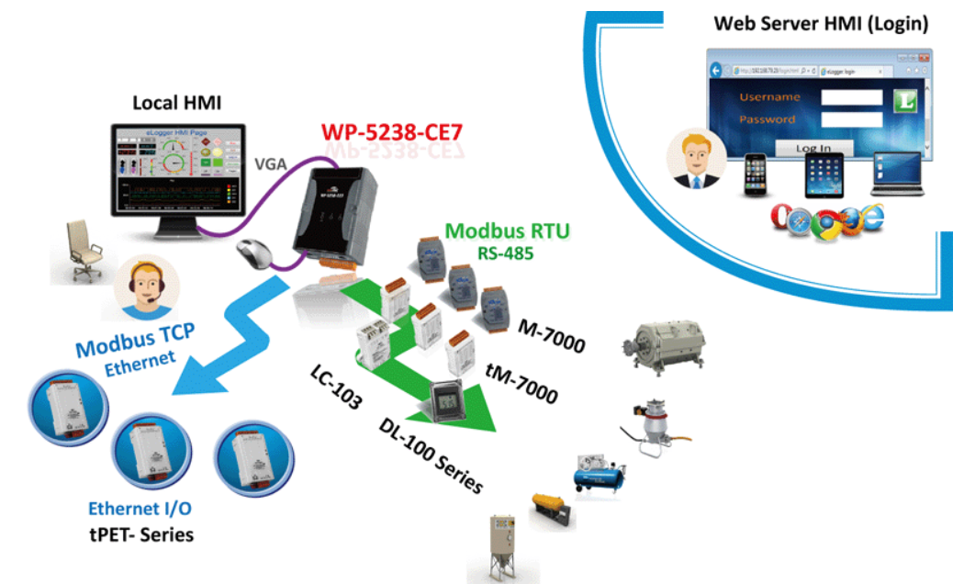
Win-GRAF & eLogger
http://www.icpdas.com/root/news/products/2017/2017062807.php

Slide 22
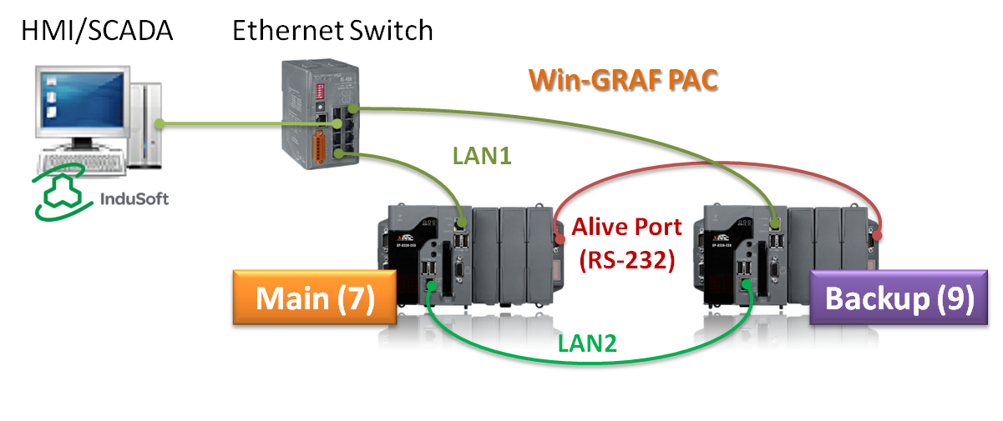
Win-GRAF Features
Controller Redundancy #1
LAN1: Public port (to connect the SCADA)
LAN2: Replication port (to synchronize data between two PACs)
RS-232: Alive port (to detect the PAC living)
Even one cable can make the redundancy work

Slide 23
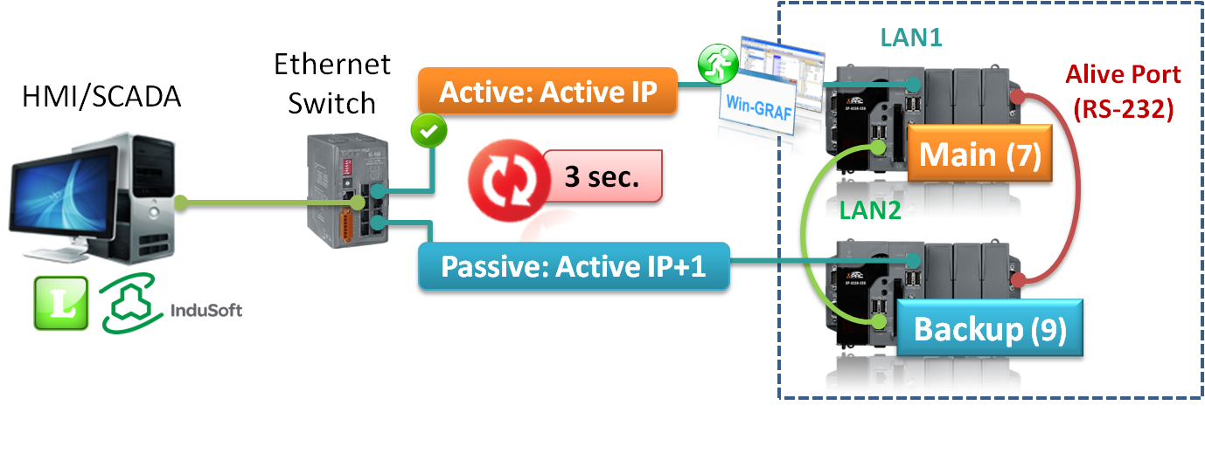
Win-GRAF Features
Controller Redundancy #2
SCADA just connects to the Active_IP
The two PAC will automatically switch Active_IP and Passive_IP
If the Active PAC is unavailable, the normal one will take over in 3 seconds
The project will be automatically restored to the new one

Slide 24
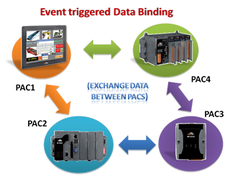
Win-GRAF Features
Data Binding
Can get data from max. of another 16 PACs

Slide 25
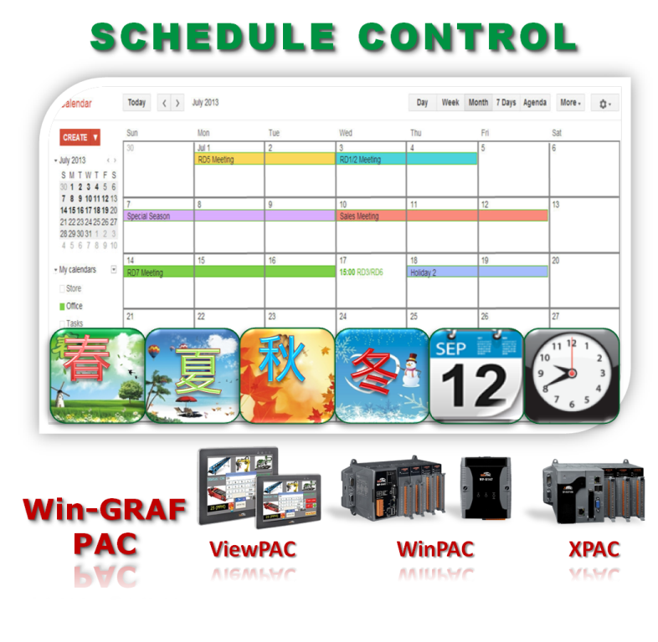
Win-GRAF Features
Schedule Control
Supports “Schedule-Control
Utility” (freeware)
One PAC can implement
max. 10 Targets (devices)
with different schedule
control.
Can apply schedule in
Day, Holiday, Special Day,
Season, Year.
25

Slide 26
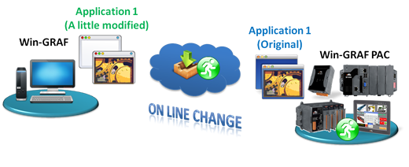
Win-GRAF Features
On-line Change
Change the code of a program (LD, ST, IL)
Change the condition of a SFC transition or the actions of a SFC step
Create, rename or delete global and local variables
Create, rename or delete global and local function block instances

Slide 27
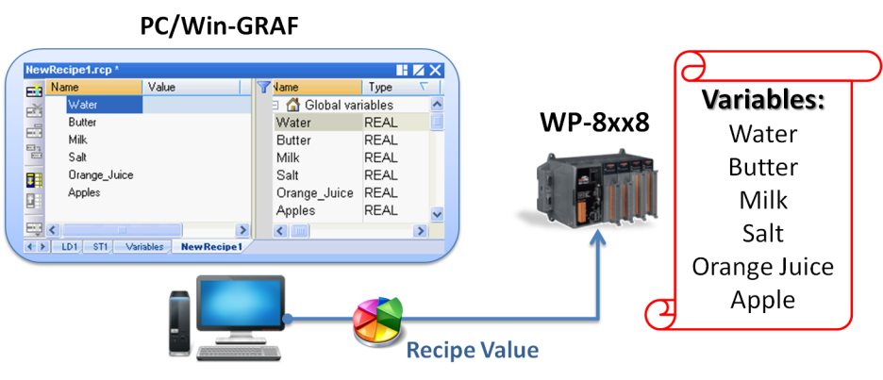
Win-GRAF Features
Recipe

Slide 28
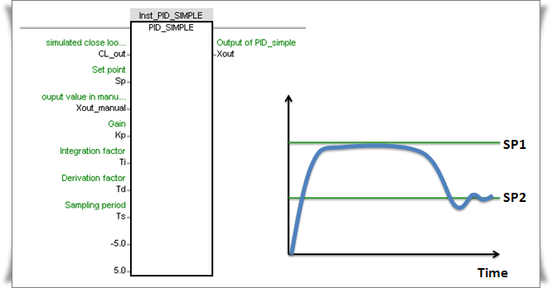
Win-GRAF Features
PID Control
One PAC can handle more than 200 PID.

Slide 29
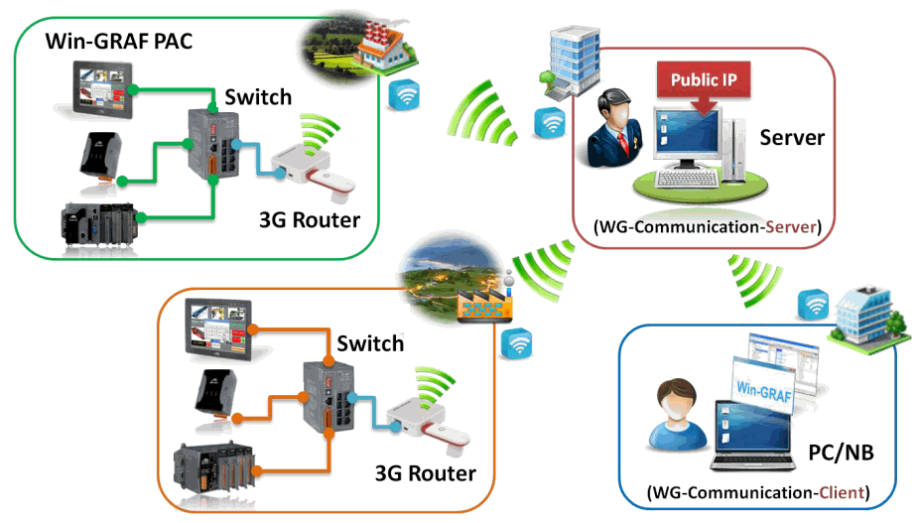
Win-GRAF Features
Intelligent Win-GRAF 3G Solution

Slide 30
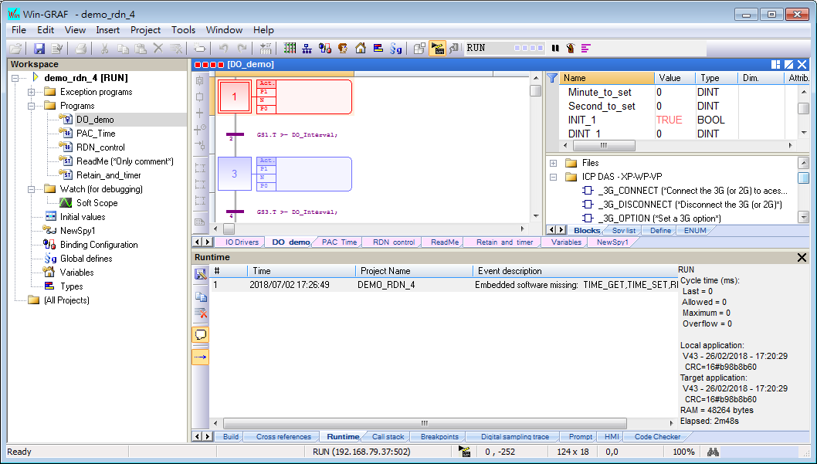
Win-GRAF Features
Simulation
Using the Simulation to test or debug the program.

Slide 31
Basic Concepts For Programming

Slide 32
Variables
Name : Starting with “A” ~ “Z”
Case insensitive , “MOT” is same as “moT”
Can use 0 ~ 7 or “_” for 2nd ~ *th character
Input / Output variable only appear in I/O boards
Function block instance variables must assign type as a function block name, for example, the type of the Inst_TIME_GET variable must be TIME_GET.

Slide 33
Variable Types
Type | Bits | Value range
BOOL (*) | --- | TRUE，FALSE
SINT | 8 bits (Small int, signed) | -128 ~ +127
USINT | 8 bits (Unsigned small int) | 0 ~ +255
BYTE
INT | 16 bits (Int, signed) | -32768 ~ +32767
UINT | 16 bits (Unsigned int) | 0 ~ +65535
WORD
DINT (*) | 32 bits (Double int, signed) | -2147483648 ~ +2147483647
UDINT | 32 bits (Unsigned double int) | 0 ~ +4294967295
DWORD
LINT | 64 bits (Large int, signed) | -2⁶³ ~ +(2⁶³-1)
ULINT (No support) | 64 bits (Unsigned large int) No support the Win-GRAF PAC. | 0 ~ +(2⁶⁴-1)
LWORD (No support)
REAL (*) | 32 bits (Floating point) | ±3.4×10⁻³⁸ ~ ±3.4×10³⁸
LREAL | 64 bits (Floating point) | ±1.7×10⁻³⁰⁸ ~ ±1.7×10³⁰⁸
STRING (*) | Max. 255 characters | ---
TIME (*) | 32 bits | T#0ms ~ T#23h59m59s999ms
*: Common

Slide 34
TIME Variable
Value : T#23h59m59s999ms
Always positive, “-T#5s “ is wrong
“T#10.5s” is wrong, “T#10s500ms” is correct
Can tick / stop / reset a time variable
tStart(TIME_VAR1) ;
tStop(TIME_VAR1) ;
TIME_VAR1 := T#0s ;

Slide 35
Type Conversion
Math calculation should use same type.
Wrong : DINT01 := REAL01 + 5 ;
Correct: DINT01 := Any_To_DINT(REAL01) + 5 ;
Comparing value should use same type.
Wrong : if DINT01 > REAL01 then
Correct: if Any_To_REAL(DINT01) > REAL01 then

Slide 36
Type Conversion Functions
Help on Win-GRAF workbench, search “conversion”
Any_To_BOOL , Any_to_SINT
Any_To_INT , Any_To_DINT
Any_To_LINT , Any_to_REAL
Any_To_LREAL , Any_To_TIME
Any_To_STRING , NUM_To_STRING
BIN_To_BCD , BCD_To_BIN

Slide 37
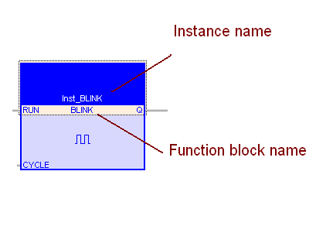
Function Block Instance

Slide 38
ST Basics 1
(* Here is comment *)
Each statement ends with a “;”
A := B + C ; (* “:=“ means assign *)
if A <= D then
(* do operations … *)
end_if ;

Slide 39
ST Basics 2
“:=“ means assignment
A := B * 5 ; (* correct *)
A = B * 5 ; (* wrong *)
“=“ means “are they equal ?”, result is TRUE or FALSE
if A = B then (* correct *)
end_if ;
if A := B then (* wrong *)
end_if ;

Slide 40
Call a Function in ST
Return_val := fun_name(par1,par2, …) ;
or
fun_name(par1,par2, …) ;
example:
OK1 := COM_OPEN( 2 , ‘9600,N,8,1’ ) ;
COM_OPEN( 2 , ‘9600,N,8,1’ ) ;

Slide 41
Call a Function Block in ST
First declare a FB instance , type = FB name
fb_instance_name(par1,par2, …) ;
Return1 := fb_instance_name.out_par1;
Return2 := fb_instance_name.out_par2;
…
example: my_unpack8 (type “unpack8”)
my_unpack8( BYTE1) ;
BOO0 := my_unpack8.Q0 ;
…
BOO7 := my_unpack8.Q7 ;

Slide 42
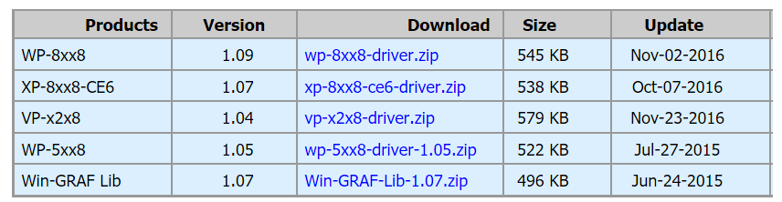
Have a try
Runtime Driver for PAC
Note: The Win-GRAF Driver can run only 2 hours on the controller (PAC) without runtime license.

Slide 43
Have a try
Developer for PC
Available on Windows XP/7/8/10
Limitation in Demo Mode:
  Applications are limited to 40 I/Os
  The code generated by the compiler and run in the controller (PAC) stops after 15 minutes
  The simulation on PC stops after 15 minutes

Slide 44
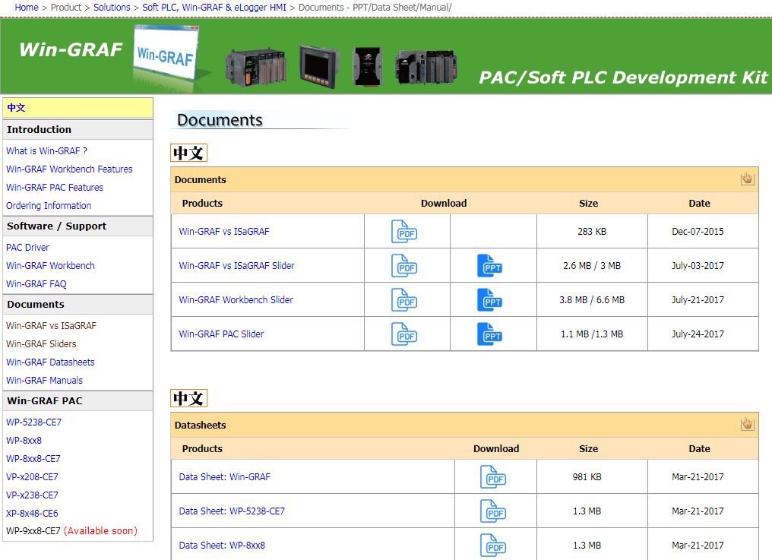
Further Information
http://www.icpdas.com/root/product/solutions/softplc_based_on_pac/win-graf/download.html

Slide 45
Thank you!

